Slide 1



Highlights from WP1 & Impact Assessment Guidance
George Panagakos
Senior Researcher
Technical University of Denmark (DTU)
25th June 2024
SOLUTIONSplus Final Event
Accelerating the Urban Electric Mobility Transition

Slide 2

The SOL+ impact assessment methodology
Objective:
Assess the demonstration activities and provide input for designing a scaled-up project that reflects the priorities of the local stakeholders
Three types of assessment:
Ex ante assessment of the demonstration project
Ex post assessment of the demonstration project
(Ex ante) assessment of the scaled-up project
Combination of:
Cost-benefit analysis (CBA) [for the financial part]
Multi-criteria decision analysis (MCDA) [for everything else]

Slide 3
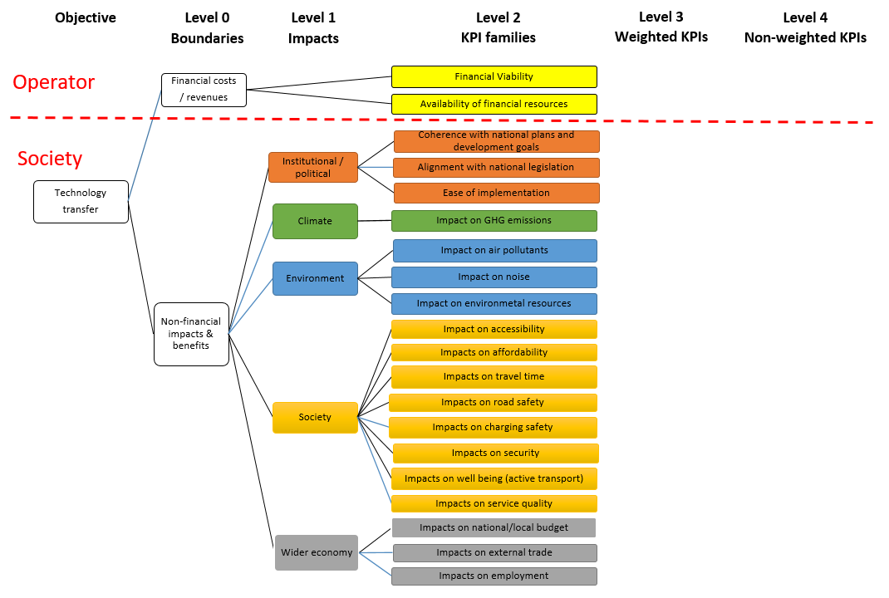
The SOL+ decision tree
Ex ante demo
Ex post demo
Scaled up
N = 20

Slide 4
Stakeholder input

Slide 5
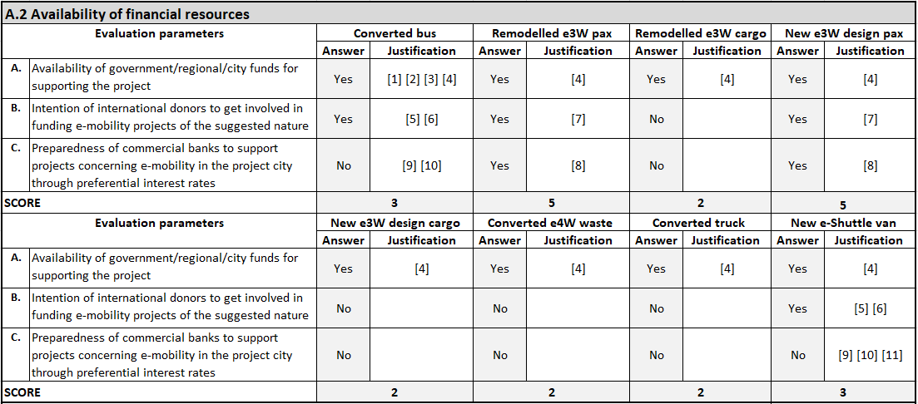
Expert input

Slide 6
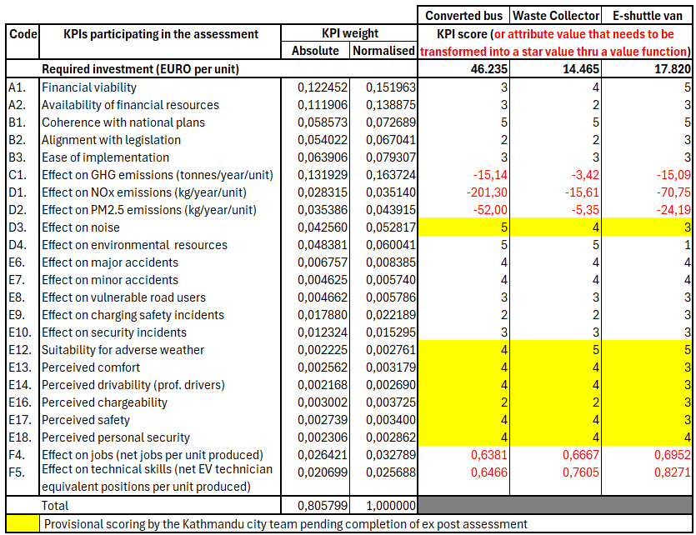
Optimising the scaled-up project
Objective function
Maximise star value
Constraints
Investment ≤ 2 MEUR
Buses ≥ 10
10 ≤ Waste collectors ≤ 30
10 ≤ Shuttle vans ≤ 30

Slide 7
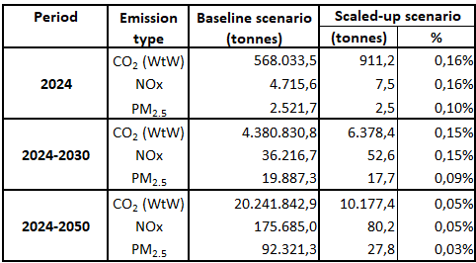
Optimisation results
Effect on emissions

Slide 8
Conclusions
Light duty EVs: good solution for developing countries:
flexibility
small dimensions
low investment requirements
Healthy return on investment
no financial support is required for their promotion
Conversions of existing vehicles: generally profitable (at lower return rates)
old fossil-fuel-driven solutions are also profitable
conversions at scale can be expected only at the end of the useful lives of existing vehicles
Lighter vehicles: very sensitive to demand forecasts
e-bikes in Dar es Salaam
e-cargo bikes in Latin America
Prerequisites:
a well-functioning distribution network & integration services (supported by an app)
collaborative business models
proper infrastructure planning (for charging & accommodating the rather bulky e-cargo bikes)
supporting regulatory framework (e.g., technical standards, licensing, etc.)
awareness raising among investors/drivers

Slide 9

Contact:
George Panagakos
+45 45 25 6514
geopan@dtu.dk

Slide 10
Thank You
25th June 2024
SOLUTIONSplus Final Event
Accelerating the Urban Electric Mobility Transition

Slide 11
The remodeled Safa Tempo (passenger use)
Investor’s perspective
Input values

Slide 12
The remodeled Safa Tempo (passenger use)
Investor’s perspective
Calculations

Slide 13
The remodeled Safa Tempo (passenger use) – Sensitivity analysis

Slide 14
The remodeled Safa Tempo (passenger use)
Existing operation
Input values

Slide 15
The remodeled Safa Tempo (passenger use)
Existing operation
Calculations

Slide 16
The remodeled Safa Tempo (passenger use)
After remodeling
Calculations

Slide 17
The new e-3-wheeler design (waste collection)

